Slide 1

Adult Dataset
By:
Ajay M, Anil G, Harika Kanthi P, Laxminarayana A, Utthejh G, Vivek M

Slide 2
Dataset is extracted from 1994 US Census data
Income depends various factors such as such as age, education, occupation, marital status, etc.
Problem: Train the binary classifier to predict if an individuals’ income is above or below $50K
Solution: Helping government agencies to target government-sponsored programs
Affordable Care Act
Introduction

Slide 3
Median Household Income of USA (1994): $34,076
Median Household Salary of USA (2019): $63,030
$50,000 (1994) is $87,083 (2020)
Affordable Care Act 2020 (Cutoff):
Single: $49,960
Household: $85,320 for a family of three
Economic Perspective

Slide 4
Name | Description | Name | Description
Age | Age of the individual | Marital Status | Marital Status of the individual
Capital Gain | Capital gains received | Native Country | Native Country of the individual
Capital Loss | Capital loss incurred | Occupation | Occupation of the individual
Education | Highest education level | Race | Race of individual
Education - num | Number of years of education | Relationship | Type of relationship
Fnlwgt | Weighted value computed by the Census Bureau | Sex | Sex of the individual
Hours Per Week | Average number of hour working per week | Workclass | Class of work of the individual
Income (Target Variable )
Dataset

Slide 5
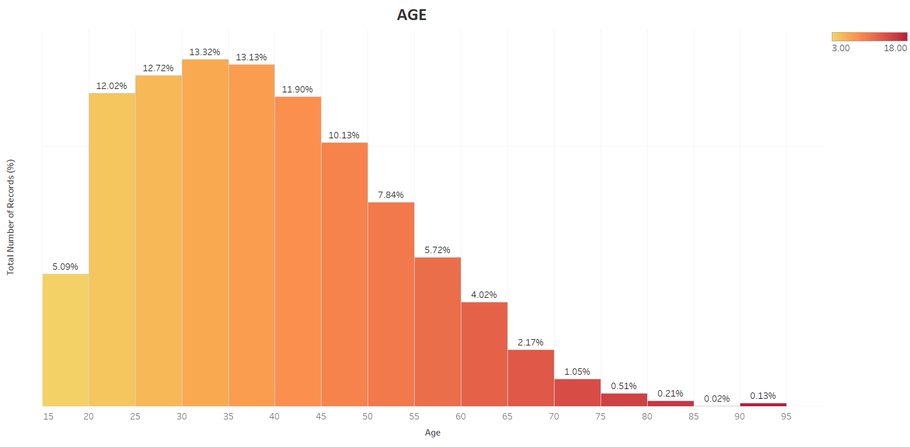
EDA – Univariate Analysis

Slide 6
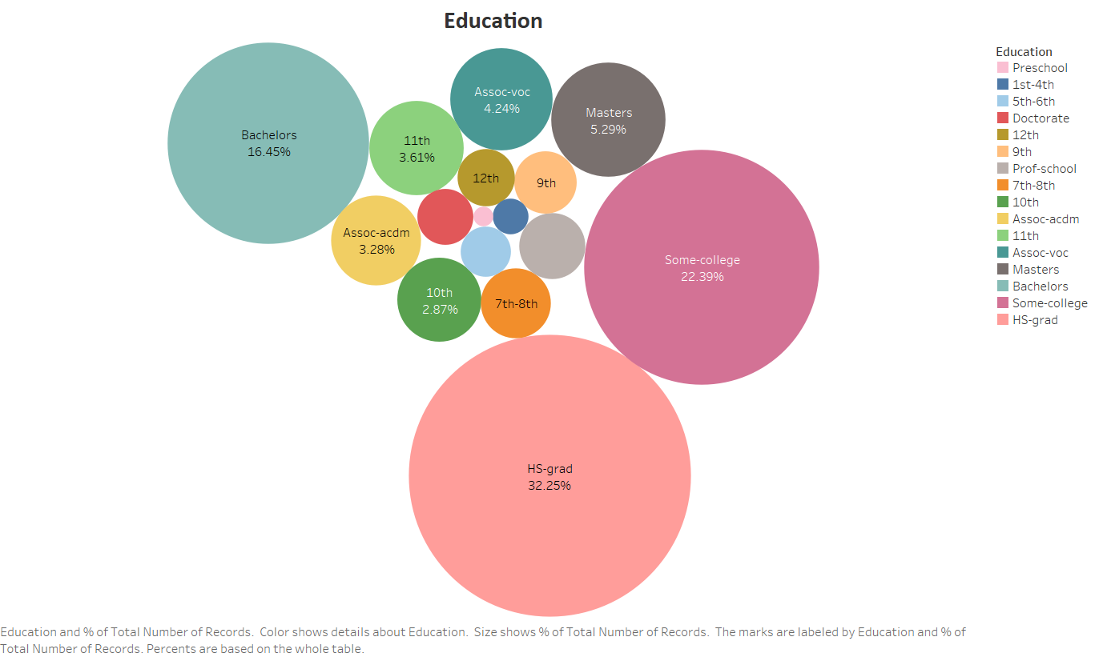
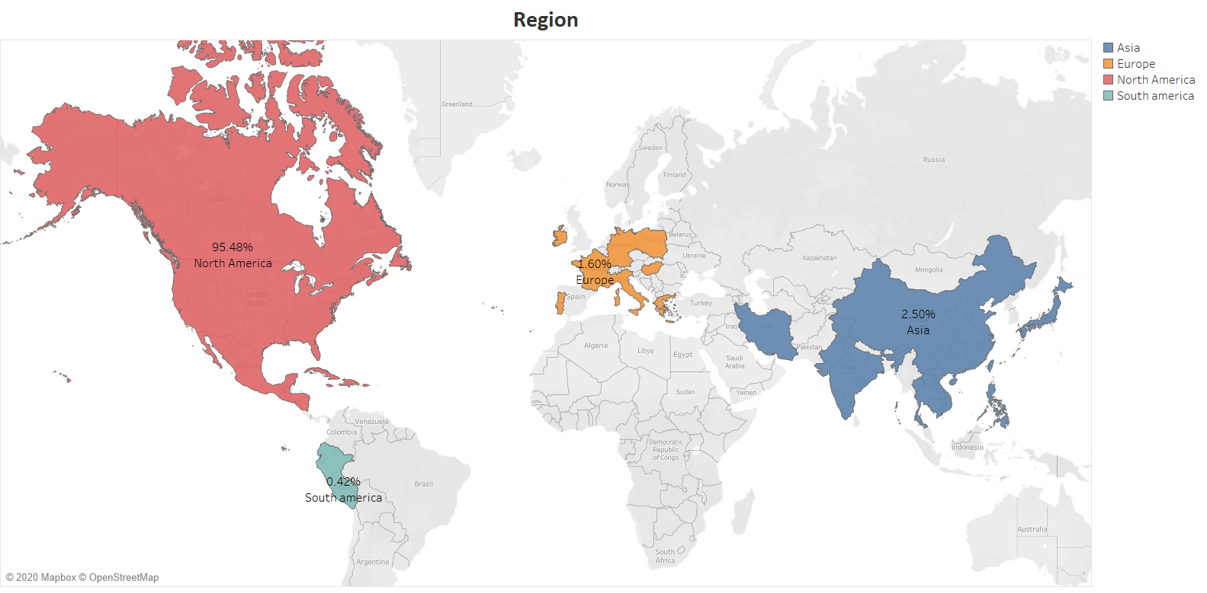
EDA – Univariate Analysis

Slide 7
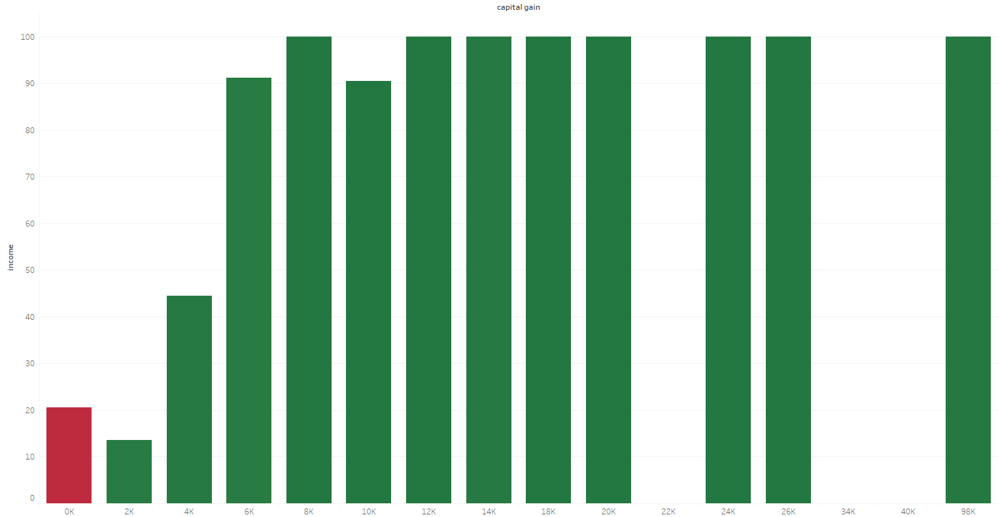
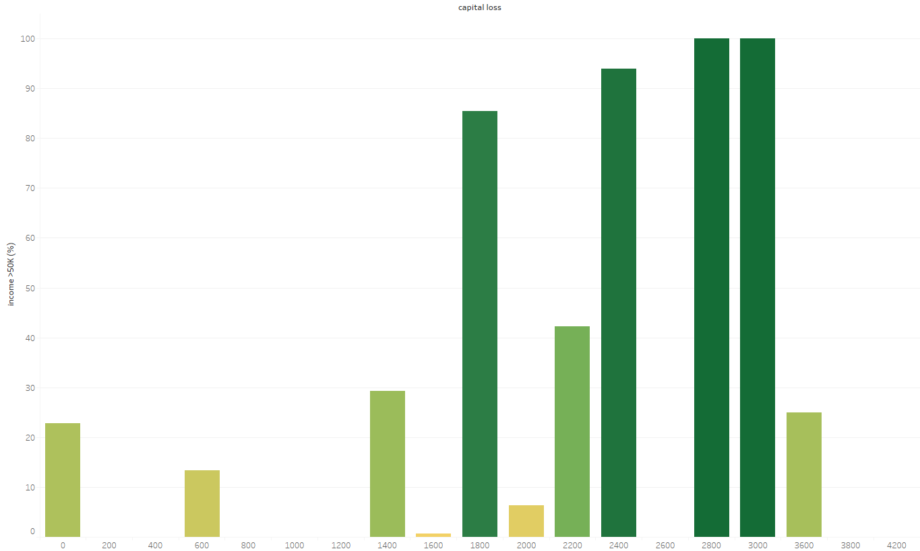
EDA - BIVARIATE ANALYSIS

Slide 8
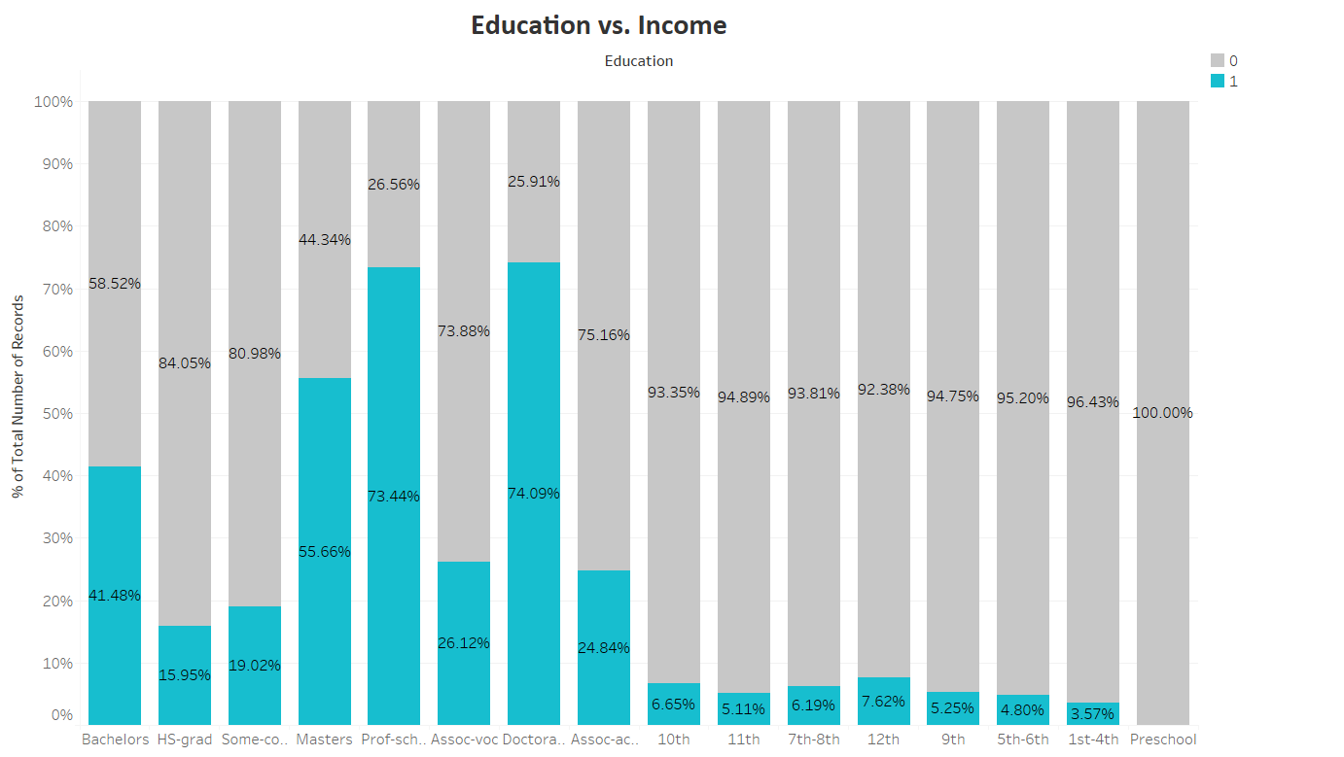
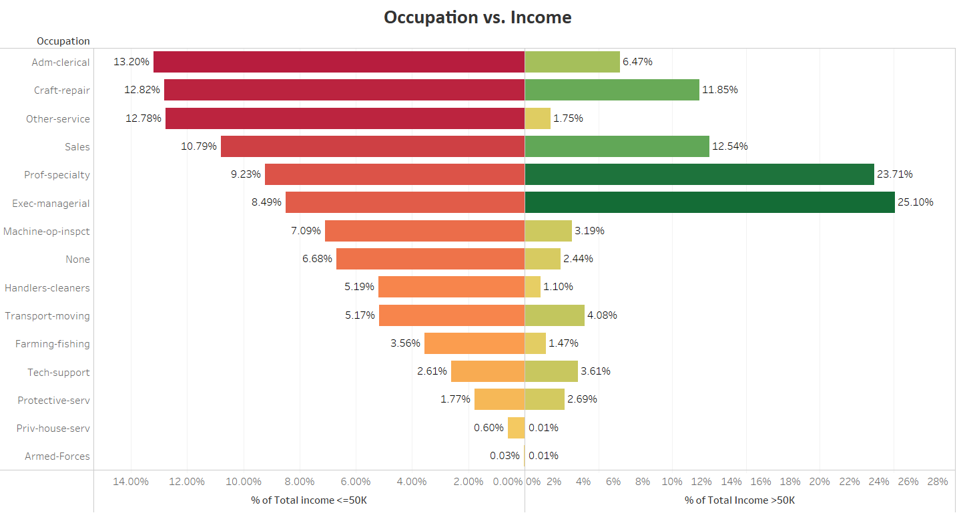
EDA - BIVARIATE ANALYSIS

Slide 9
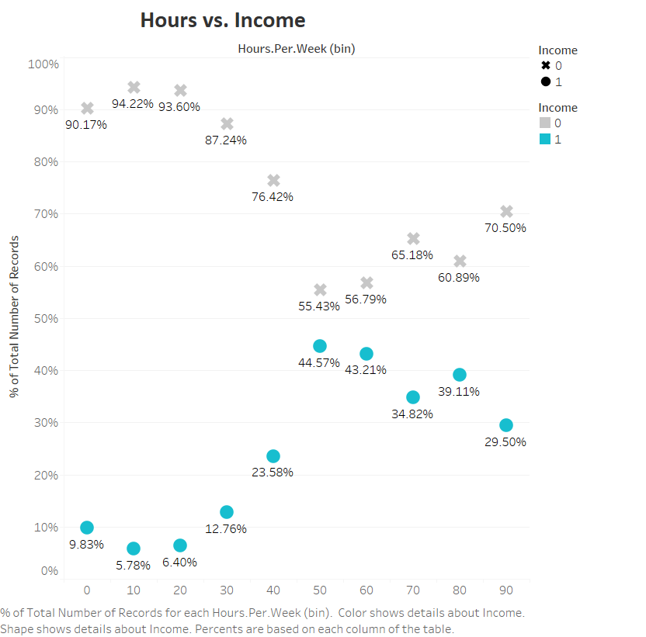
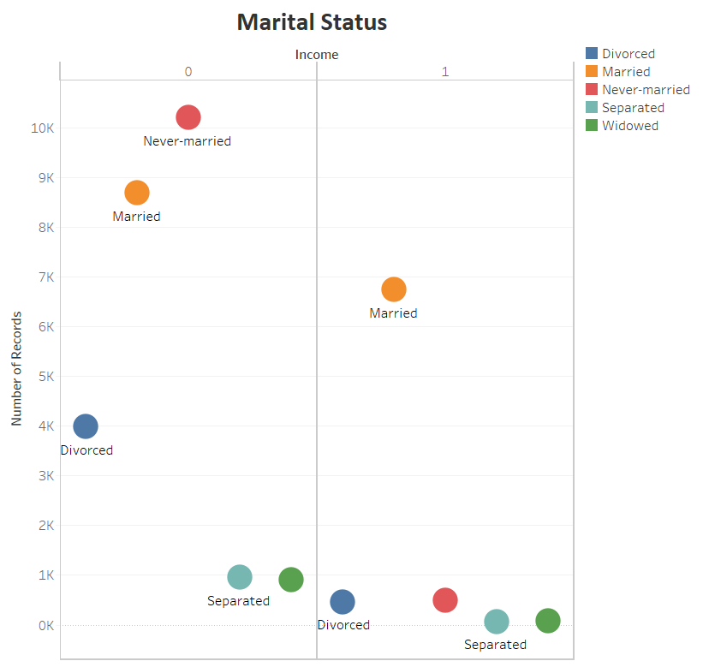
EDA - BIVARIATE ANALYSIS

Slide 10
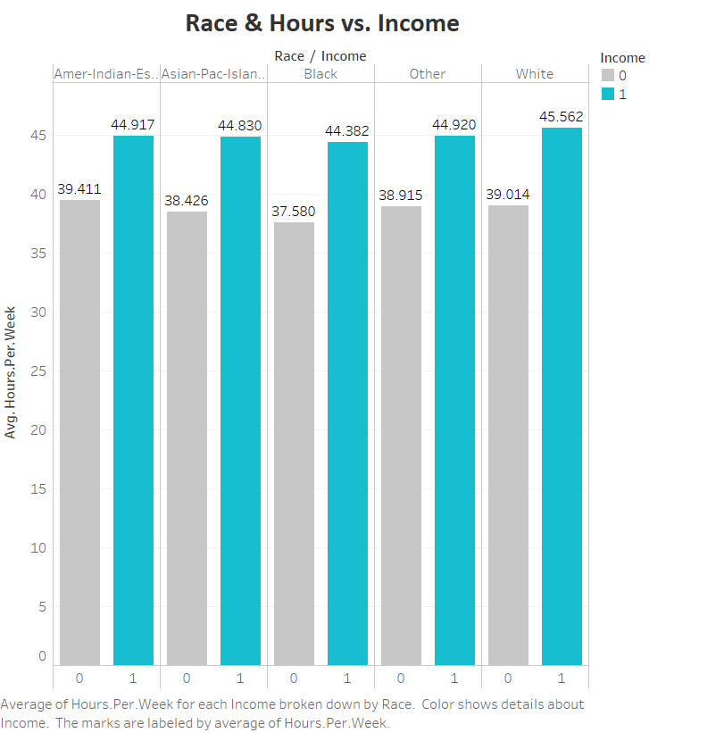
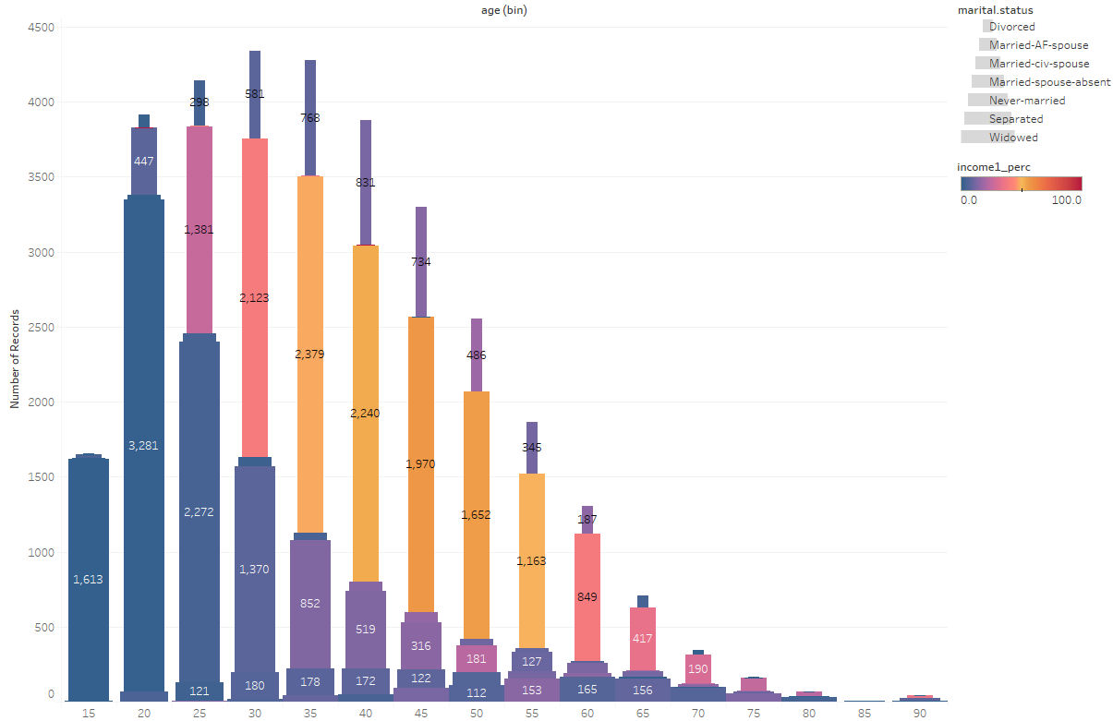
EDA - MULTIVARIATE ANALYSIS

Slide 11
Statistical Testing
Features | Statistics | P-Value | Significant
age | 1876.135332 | 0.000000e+00 | Yes
education.num | 3819.914386 | 0.000000e+00 | Yes
capital.gain | 1551.576577 | 0.000000e+00 | Yes
hours.per.week | 1676.548626 | 0.000000e+00 | Yes
marital.status | 6061.747963 | 0.000000e+00 | Yes
occupation | 3687.620651 | 0.000000e+00 | Yes
relationship | 6233.840454 | 0.000000e+00 | Yes
sex | 1413.146829 | 2.921492e-309 | Yes
workclass | 804.157527 | 1.946096e-170 | Yes
capital.loss | 694.724841 | 2.182812e-151 | Yes
race | 304.241374 | 1.317829e-64 | Yes
native.country | 317.736675 | 6.221222e-45 | Yes
fnlwgt | 2.420095 | 1.197982e-01 | No

Slide 12
DATA CLEANING
Education Number and Education
Misclassification
Omitting
Null value imputation
USA data
K Nearest Neighbors Imputation
Work class
5.6%
Country
2%
Occupation
5.6%

Slide 13
DATA PREPARATION
Feature creation
Feature Selection
Data Scaling
Standardisation
Statistical Testing
ARSC

Slide 14
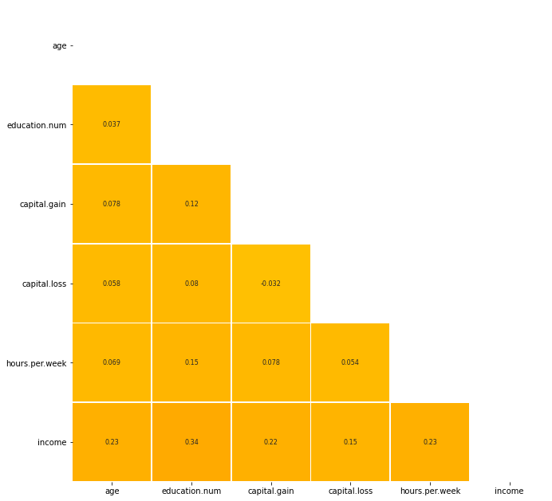
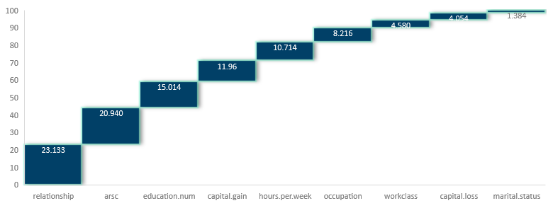
MODEL BUILDING
FEATURE IMPORTANCES
Data | Logit Accuracy | Train Accuracy | Test Accuracy | ROC_AUC | F1 Score
Dropping NA |  | 0.979633 | 0.809261 | 0.739861 | 0.610911
USA data |  | 1.000000 | 0.801139 | 0.741249 | 0.613063
KNN imputation |  | 0.984735 | 0.817836 | 0.755650 | 0.626918
KNN with ARSC |  | 0.978010 | 0.863852 | 0.778724 | 0.687852

Slide 15
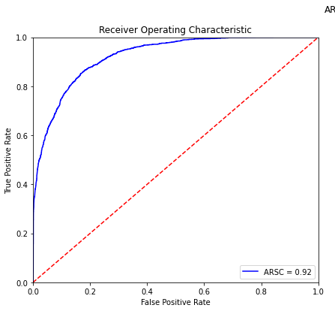
MODEL BUILDING
Data | Train Accuracy | Test Accuracy | ROC_AUC | F1 Score
Dropping NA | 0.886194 | 0.866457 | 0.795094 | 0.712272
USA data | 0.866291 | 0.862637 | 0.777618 | 0.687924
KNN imputation | 0.872318 | 0.869549 | 0.789358 | 0.700845
KNN with ARSC | 0.861940 | 0.827540 | 0.830853 | 0.700384

Slide 16

Thank you

